Slide 1
UNLOCKING HOME VALUE THROUGH RENOVATION: A Data-Driven Approach.

Slide 2
Done By:
Ian Vaati.
Bernadette Nganga.
Muthoni Kahuko.

Slide 3
01
INTRODUCTION
02
DETAILS
03
MODEL DEVELOPMENT
04
BUSINESS RECOMMENDATIONS
05
LIMITATIONS
CONTENTS

Slide 4
INTRODUCTION
Empowering Homeowners with Informed Renovation Decisions.

Slide 5
PROJECT DESCRIPTION
01
BUSINESS
PROBLEM :
Homeowners often wonder how renovations will impact their home’s value.
This uncertainty often makes it challenging to decide on home improvements and investments.
We’ve developed a predictive model using data to estimate the value of various renovation features.
This model will empower homeowners to make informed decisions about renovations.
SOLUTION :

Slide 6
DETAILS
A Data-Driven Approach.

Slide 7
02
To achieve this we took several key steps:
Data Analysis.
Model Development.
Predictive Analysis.

Slide 8
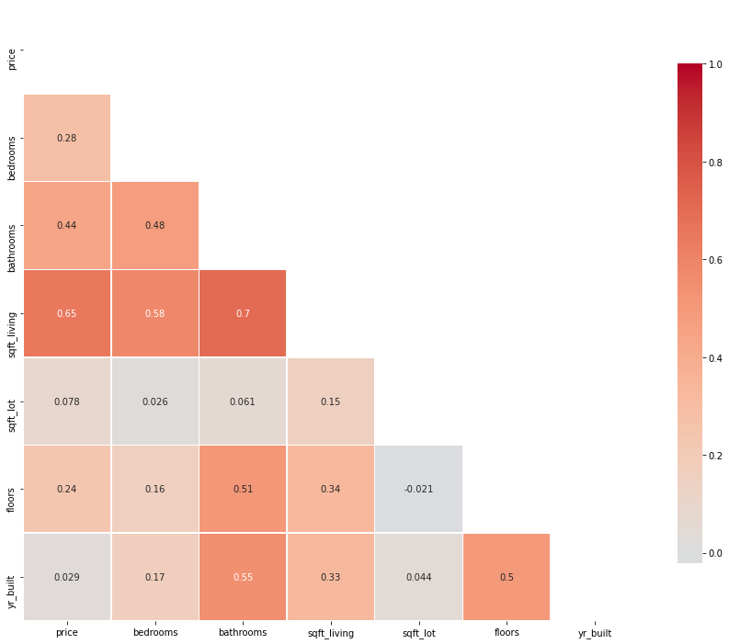
Data Analysis.
We worked and checked the data to understand the relationship between different features of the house with the price as well as each other.
Key pointers;
Here we get to know that the square footage of the living space had an effect on the pricing of the building more than any other feature of the house.

Slide 9
MODEL DEVELOPMENT.

Slide 10
FLOWCHART: Predictive Model for Renovation Impact.
03
Predictive Model
Data Collection
(getting the King
County dataset)
Data Processing
(data is being cleaned,
transformed and prepared for the model)
Training
(The model is learning from historical data)
Results
(The predictions are delivered to home owners)
Predictions
(The model makes predictions based on the input data)
The results
provide actionable insights for the
homeowners.

Slide 11
BUSINESS
RECOMMENDATIONS.

Slide 12

Pricing Guidance
Real estate agencies can use a
special pricing tool based on our
regression model. This tool helps homeowners understand how
improvements like renovations can impact the estimated value of their homes. It's like having a price
calculator for your house.

Slide 13
Smart Renovation Advice
Agencies can use the model's insights to give homeowners
advice on what renovations will make the most difference.
Imagine getting personalized
recommendations on which
renovations will give you the
biggest bang for your buck.

Slide 14

Market Awareness
Agencies will also keep you informed about what's happening in the real estate market. This information helps you understand how market conditions may affect the value of your home after renovations. It's like having a personal real estate expert by your side.

Slide 15

Trusted Partnerships
To make your renovation
journey easier, agencies can connect you with trusted
contractors. These experts
can provide quotes and
guidance, ensuring your
renovation process is smooth and trustworthy.

Slide 16
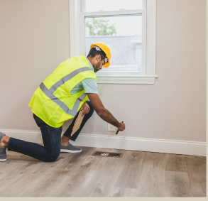
Tailored Recommendations
We believe that one size doesn't fit all. Your home is unique, and agencies can tailor their advice based on your
home's current condition, size, and
location. For example, if your home is
spacious but needs some upgrades, we can suggest ways to increase its value.

Slide 17
LIMITATIONS.

Slide 18
Limitations
Reliable Data: To get accurate predictions from our model, we need to ensure the data we use is trustworthy and up-to-date. Think of it as using the best ingredients for a recipe; better data means better results.
Market Awareness: Keep in mind that real estate markets can be influenced by many things like the economy and local events. Our model doesn't catch short-term ups and downs, so it's good to stay informed about market changes.
Budget Flexibility: While our model estimates renovation impacts, real costs can vary. Remember that the actual expenses may be different from our estimates. It's like planning a trip with a budget but being ready for unexpected expenses.
Model Updates: The real estate world is always changing. Our model should also evolve with it. Periodic updates ensure that our advice stays relevant and valuable.
Personal Touch: Your home is unique, and so are your preferences. Our model is great, but it doesn't know your personal style. Feel free to tell us what's most important to you, and we'll tailor our advice to fit your needs.

Slide 19
THANK YOU

